Slide 1


Group -11
2210176143 - Md Fayed Hasan
2110676137 - Momin Sarker
2110476113 - Md Shamim Reza
2110276105 - Md ​Shamiur Rahman Sefat
​

Slide 2
Topic
ADC with DMA, Analog Watchdog & Bit-Banding
Advanced Autonomous Monitoring System

Slide 3
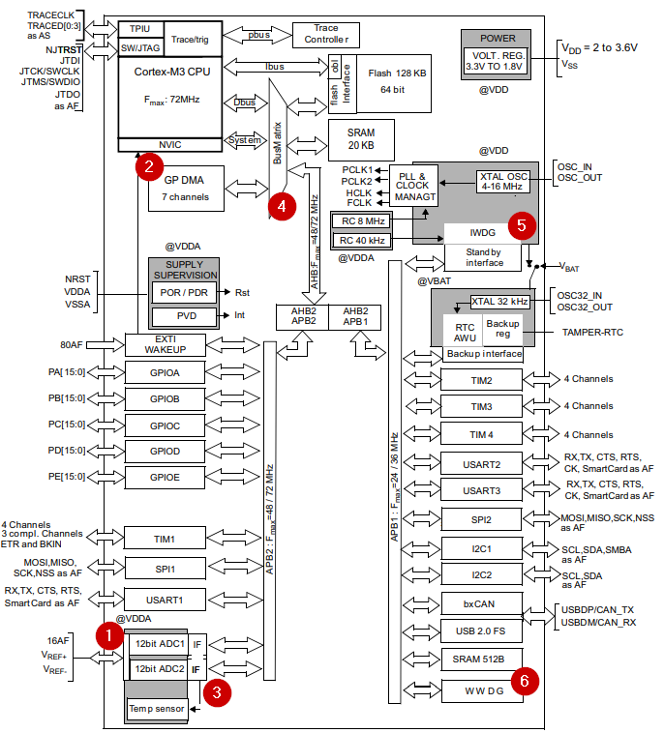

Slide 4
Traditional CPU-Based Monitoring
Software Polling Method:
while(1) {
ADC_Start();
while(!ADC_Complete()); // CPU Stuck Here
value = ADC_Read();
if(value > THRESHOLD)
Alarm();
}
Problems: • High CPU usage • Latency • Non-deterministic timing

Slide 5
Hardware-Assisted Architecture
Sensor ↓ ADC (Continuous) ↓ DMA (Circular) ↓ SRAM Buffer
Parallel: Analog Watchdog → Interrupt

Slide 6
ADC Engine
• 12-bit SAR ADC • Up to 1 Msps • 16 channels • Scan Mode • Continuous Mode • External trigger support

Slide 7
Sample Time vs Conversion Time
Tconv = Tsample + 12.5 ADC cycles
Example:
ADC clock = 12 MHz Sample time = 55.5 cycles
Total time ≈ (55.5 + 12.5) / 12MHz

Slide 8
ADC Registers
CR1: • SCAN • AWDEN • AWDIE
CR2: • CONT • DMA • ADON
SQRx: • Channel sequence

Slide 9
DMA Overview
DMA1 Channel 1 → ADC1
Peripheral-to-Memory
AHB Bus Master
Interrupt capable

Slide 10
DMA Circular Mode
DMA_CCR1: • CIRC = 1 • MINC = 1 • DIR = 0 • EN = 1
Result: Continuous Buffer Update

Slide 11
DMA + ADC Interaction
ADC Conversion Complete → Sets EOC → DMA Request Generated → Data moved to SRAM
No CPU Interrupt Needed

Slide 12
ANALOG WATCHDOG
Integrated Window Comparator
Registers: • ADC_HTR (High Threshold) • ADC_LTR (Low Threshold)

Slide 13
AWD Interrupt Mechanism
Condition:
ADC_Value > HTR OR ADC_Value < LTR
→ AWD Flag Set → Interrupt to NVIC

Slide 14
AWD vs IWDG vs WWDG
Analog Watchdog: • Monitors analog signal
IWDG: • Independent watchdog • Resets system if CPU hangs
WWDG: • Window watchdog • Checks refresh timing

Slide 15
BIT-BANDING
Each Bit → Unique Alias Address
Atomic Operation
No Read-Modify-Write

Slide 16
Why Bit-Banding Matters
Used For: • Enabling ADC • Enabling DMA • Enabling Interrupt
Prevents Race Conditions

Slide 17
Autonomous Flow
Sensor ↓ ADC (Continuous + Scan) ↓ DMA (Circular) ↓ Memory
Parallel: Analog Watchdog → CPU Interrupt

Slide 18
CPU Load Reduction
Without DMA: • CPU handles every sample
With DMA: • CPU handles only exceptions
Efficiency ↑ Power Consumption ↓

Slide 19
Real-Time Determinism
Hardware-based detection Fixed conversion time No software delay
Suitable for: • Industrial control • Motor systems • Power electronics

Slide 20
Industrial Applications
Battery Management System
Over-temperature protection
Voltage monitoring
Pressure sensing

Slide 21
Conclusion
ADC → Converts DMA → Transfers AWD → Protects Bit-Banding → Controls Safely
Together → Intelligent Embedded Monitoring System

